Slide 1
Azure-Hands-on-labs :- Set Up Load Balancing on TCP Port 80 Using Azure Load Balancer & application Gateway
I have core-vnet as a virtual network | 2 vms (core-vm & stg-vms) inside → core-vnet
Create an Azure Load Balancer “lb-01”
Create a Frontend ip
Create a Backend Pool
Create Load Balancing Rule
Configure IIS Feature and nsg to allow port 80 in inbound rule of each vm
Test connectivity using front-end-ip
Configure application gateway which it act as load balancer but on application-level features like SSL termination
Configure a dedicated subnet for appgw
configure frontend, backend and routing rules on port 80 to listen traffic on it
Test connectivity

Slide 2
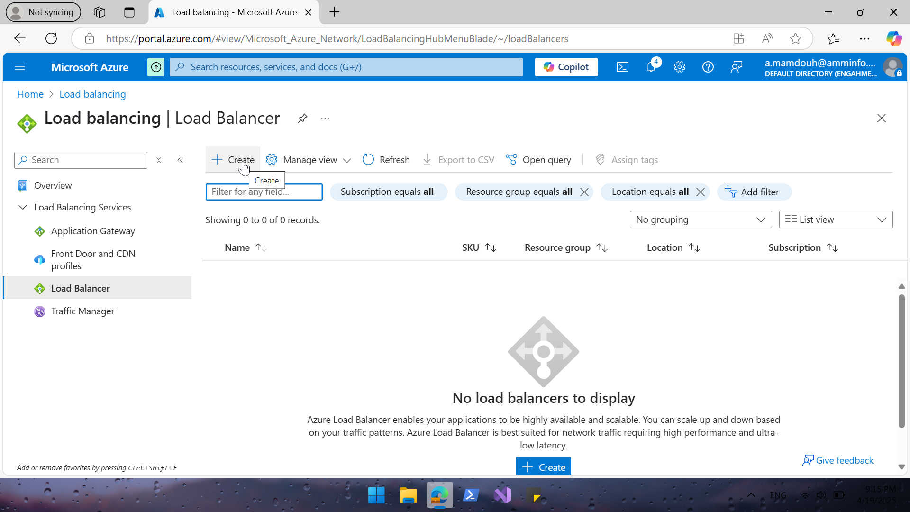
Notes:
Create a new Load Balancer

Slide 3
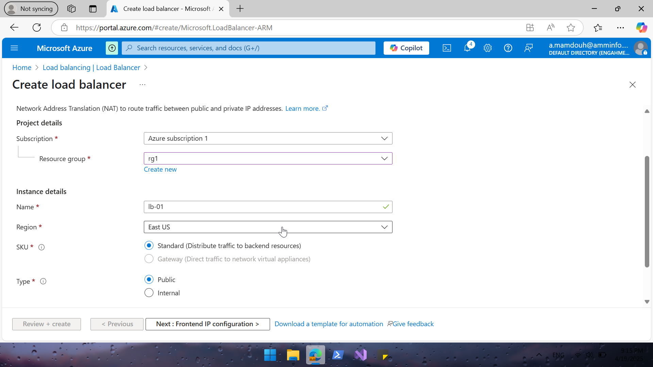
Notes:
LB Name “lb-01” and type (public or private)

Slide 4
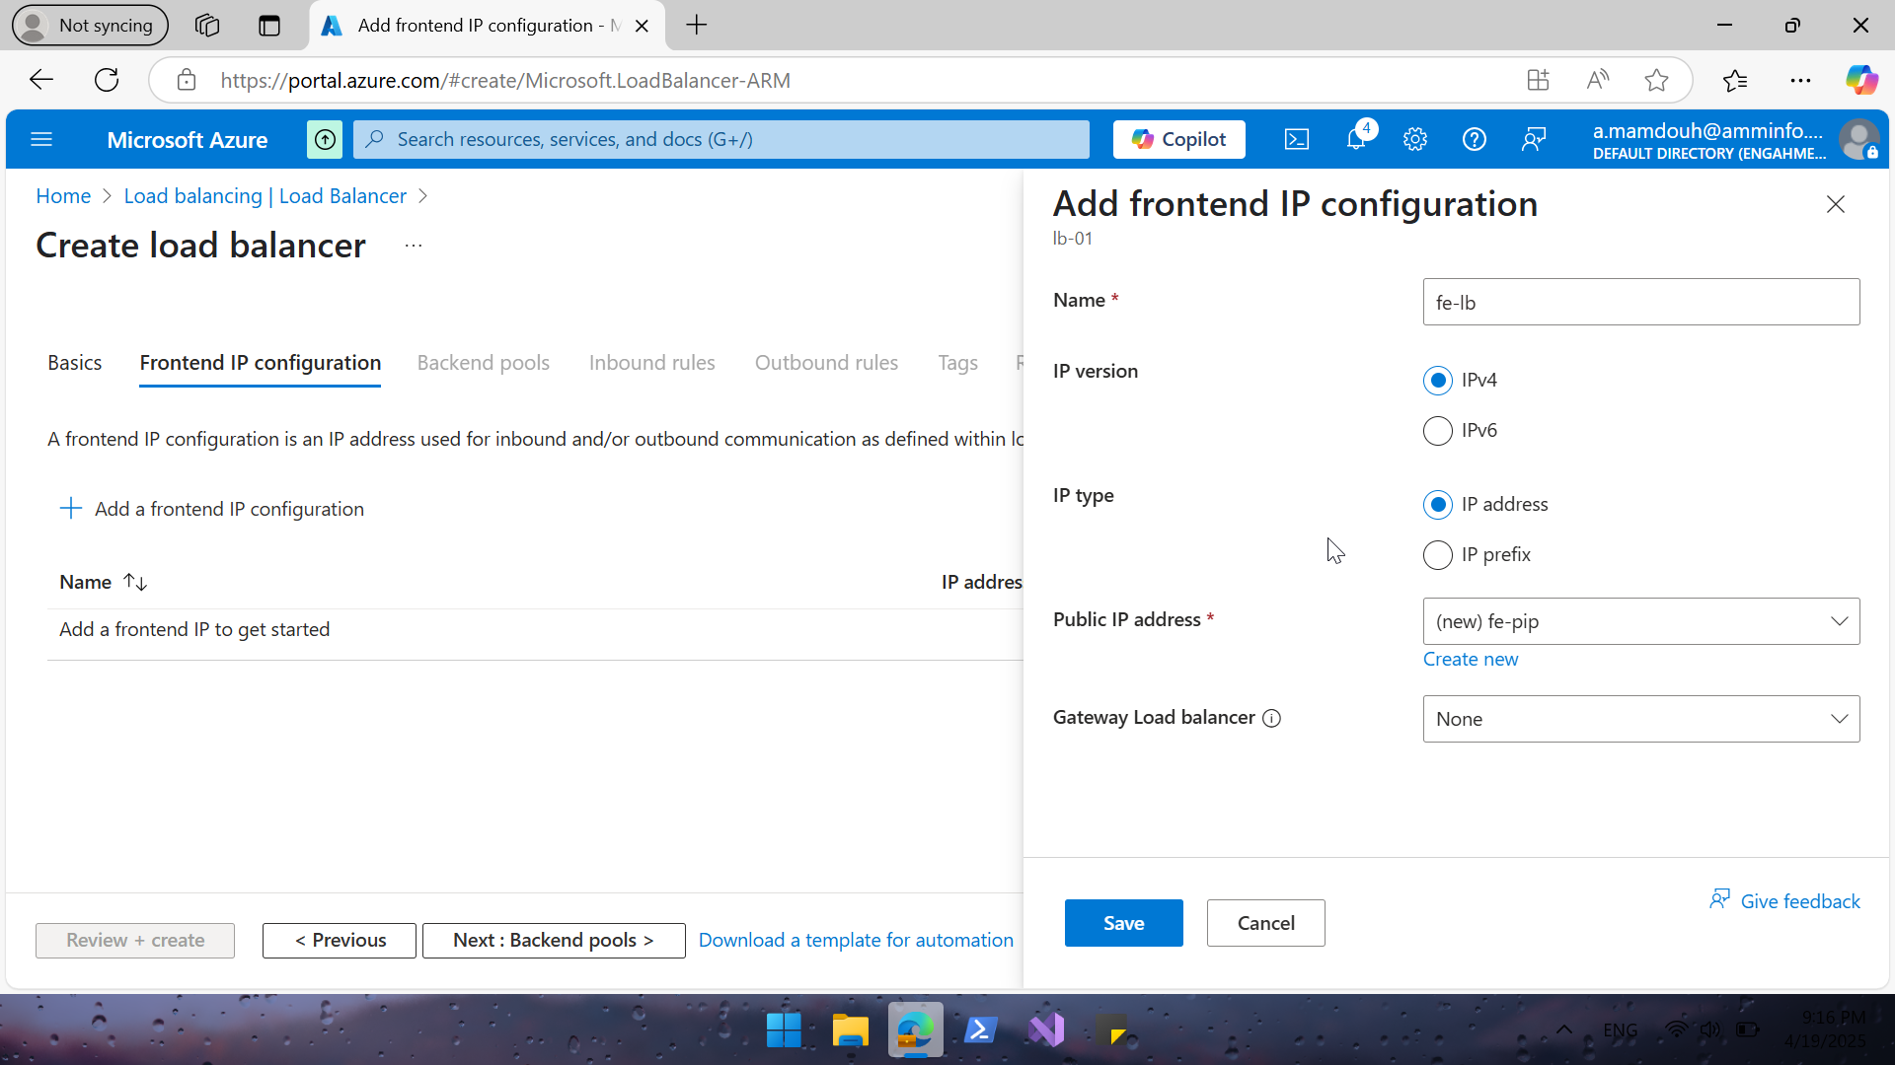
Notes:
Front End Config | define load-balancer public-ip name & type (public or private)

Slide 5
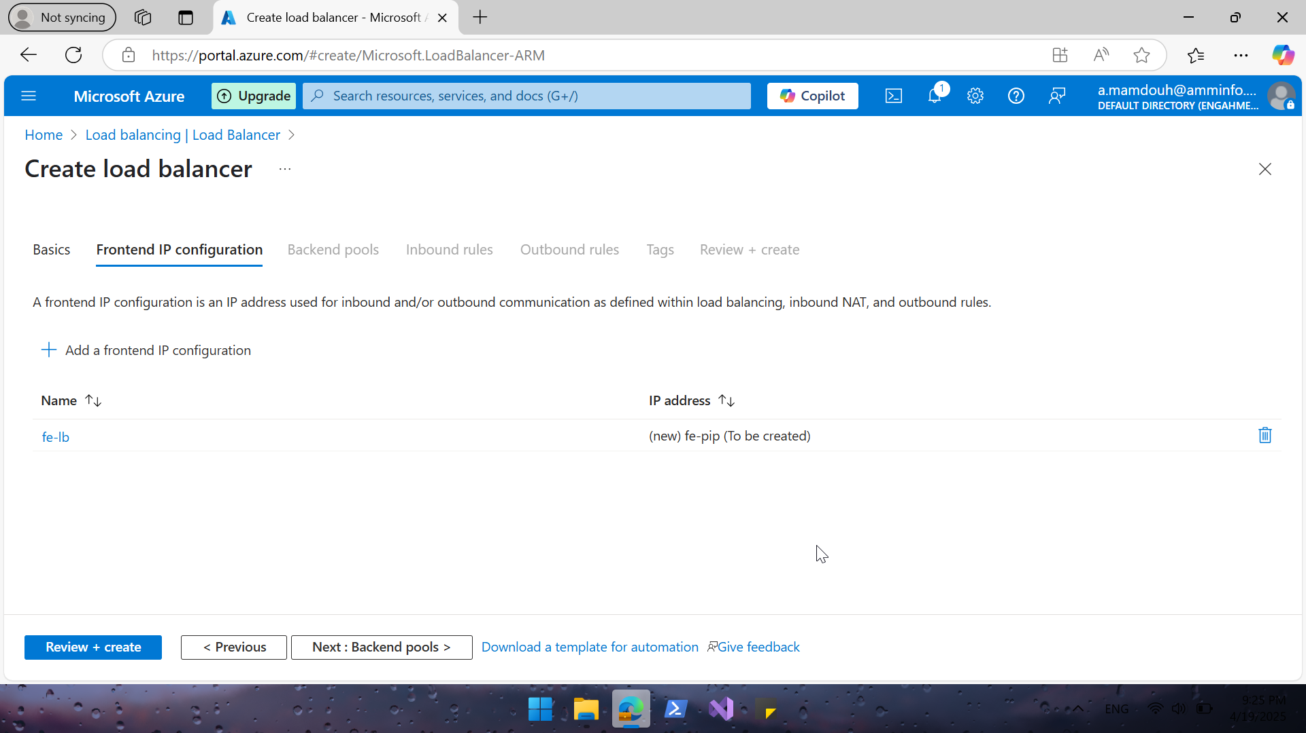

Slide 6
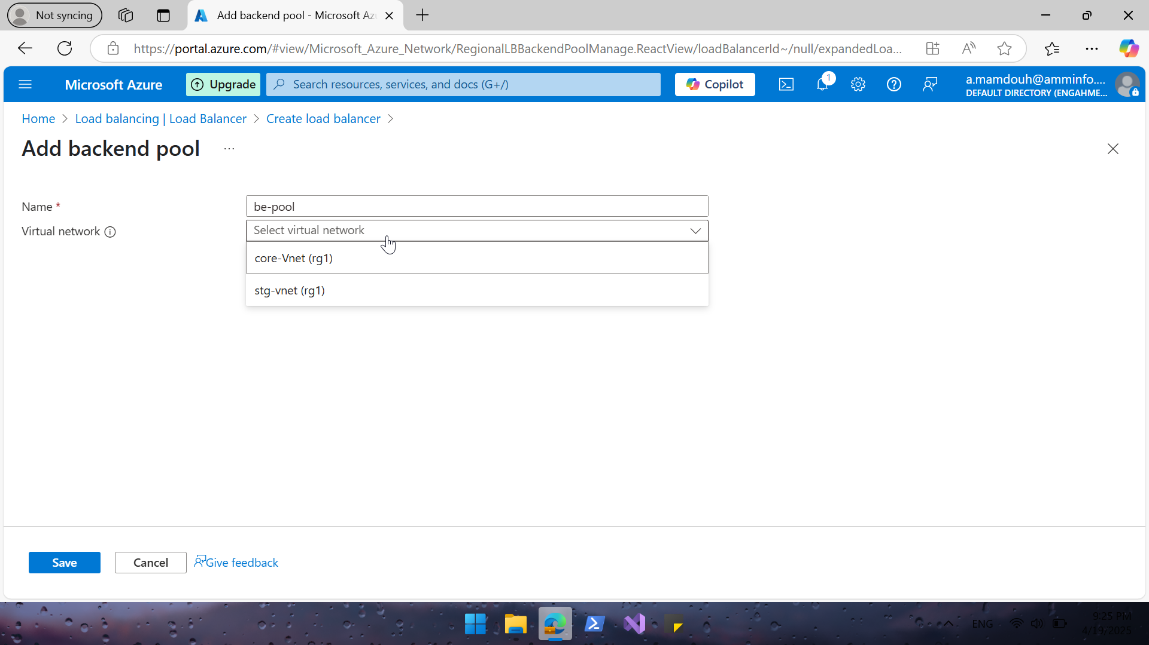
Notes:
Define backend pool, I have two-vnet which I created before I selected Core-vm

Slide 7
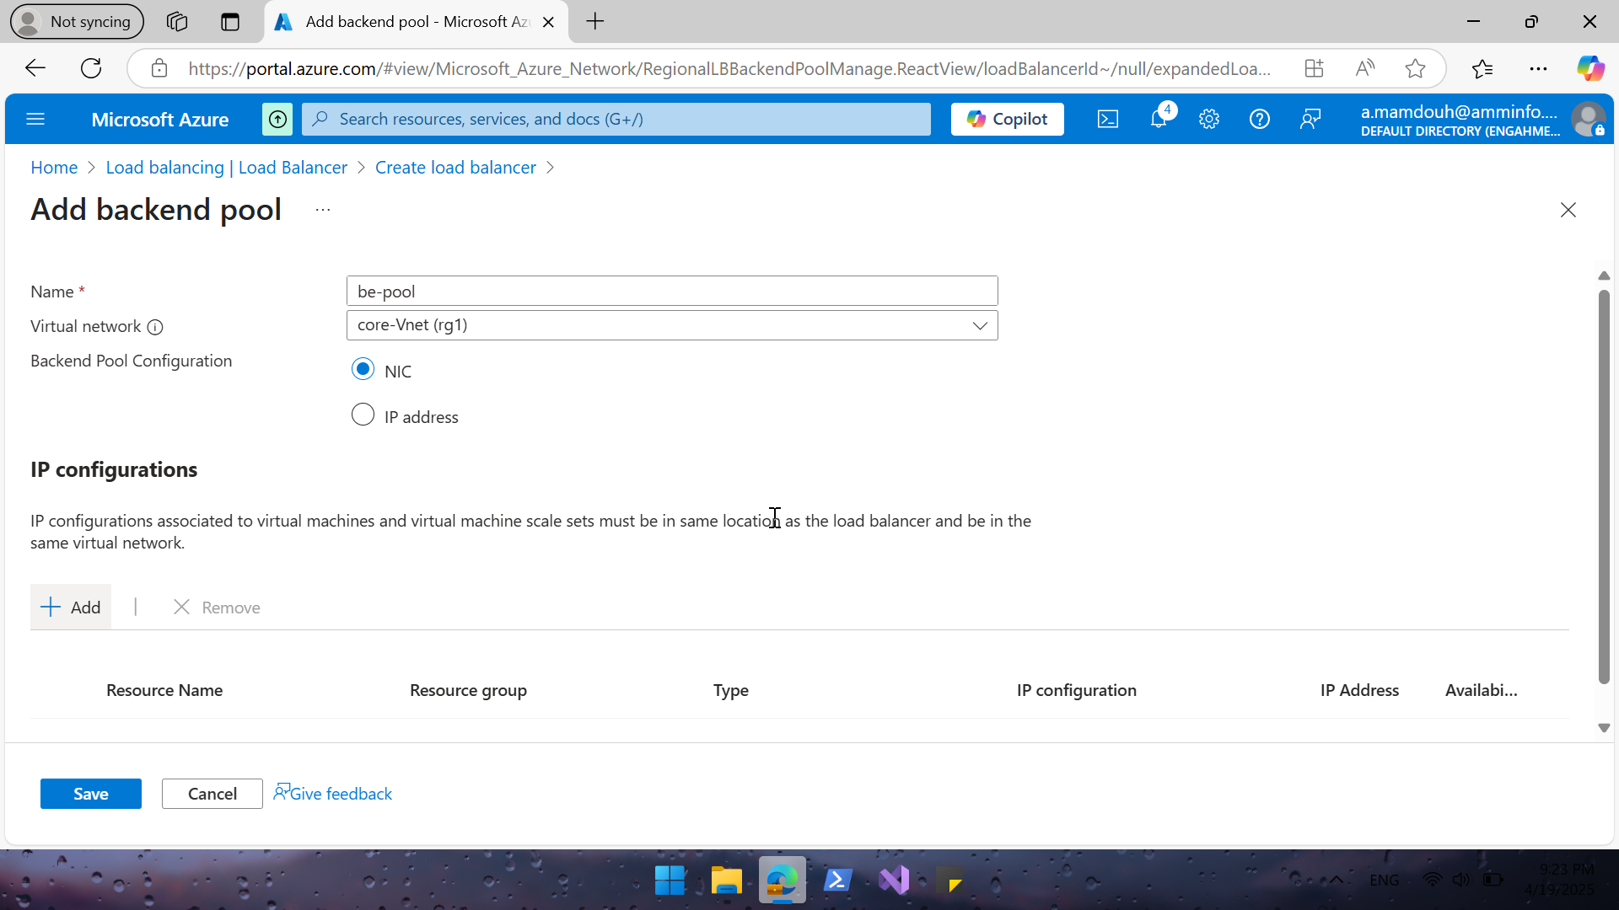
Notes:
Core-Vnet include 2-vms “core-vm & stg-vm”

Slide 8
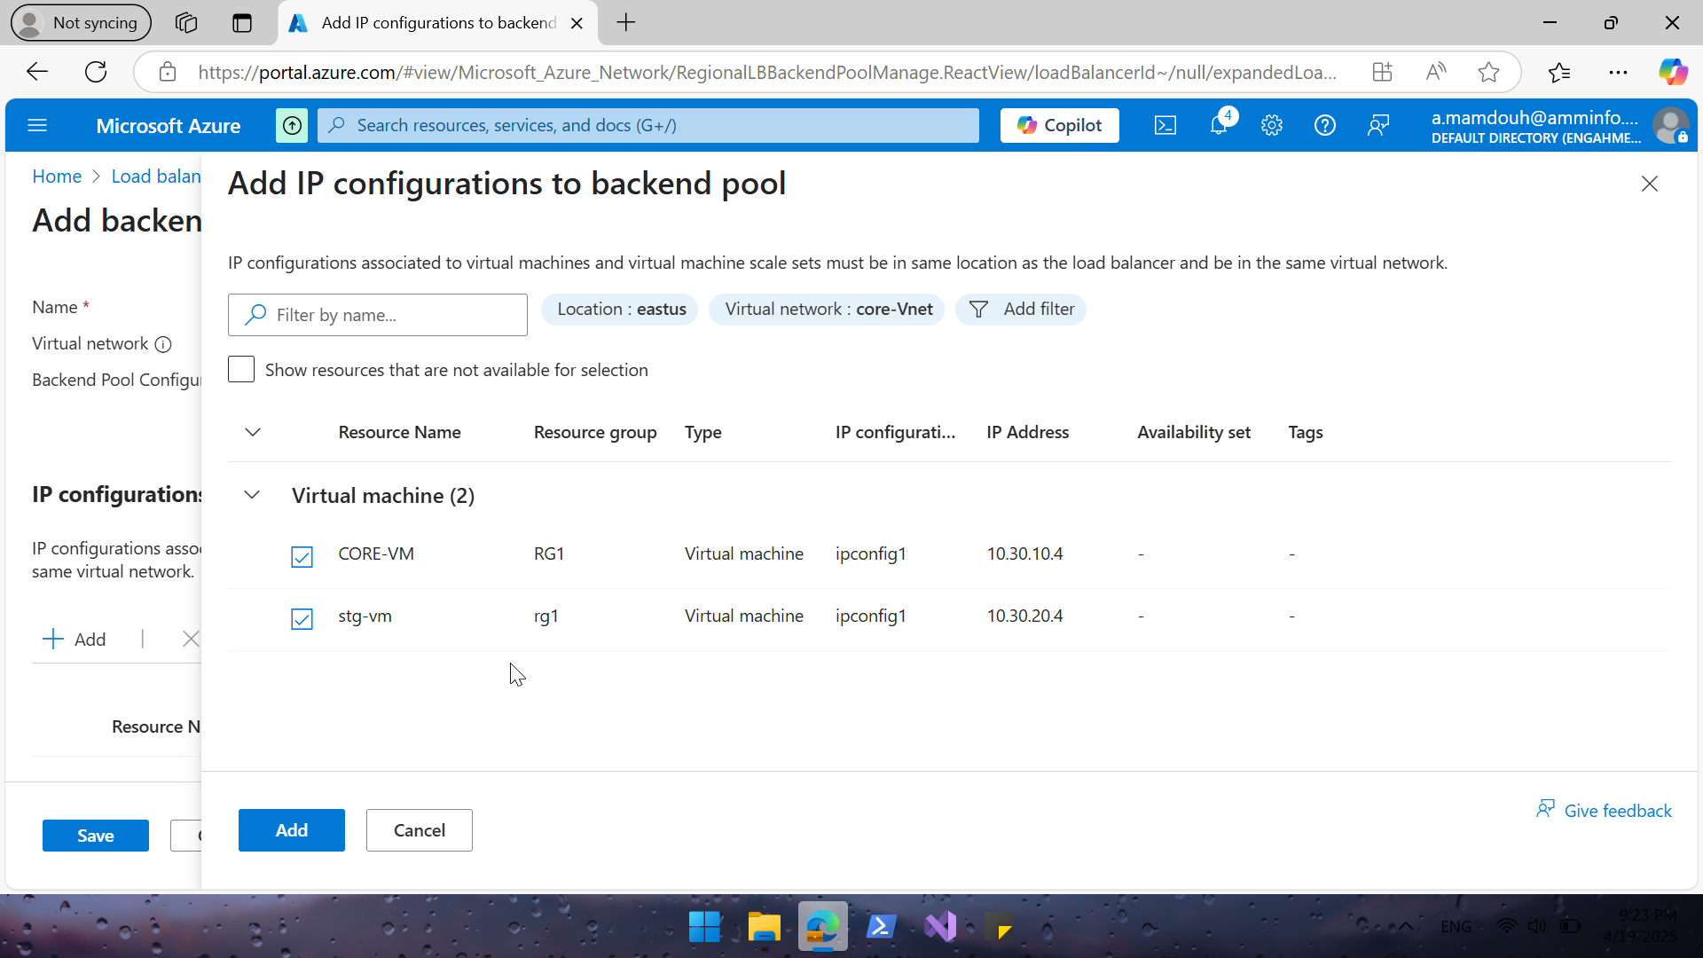
Notes:
Add 2 vms kindly note that 2 vms on the same vnet but different subnet

Slide 9
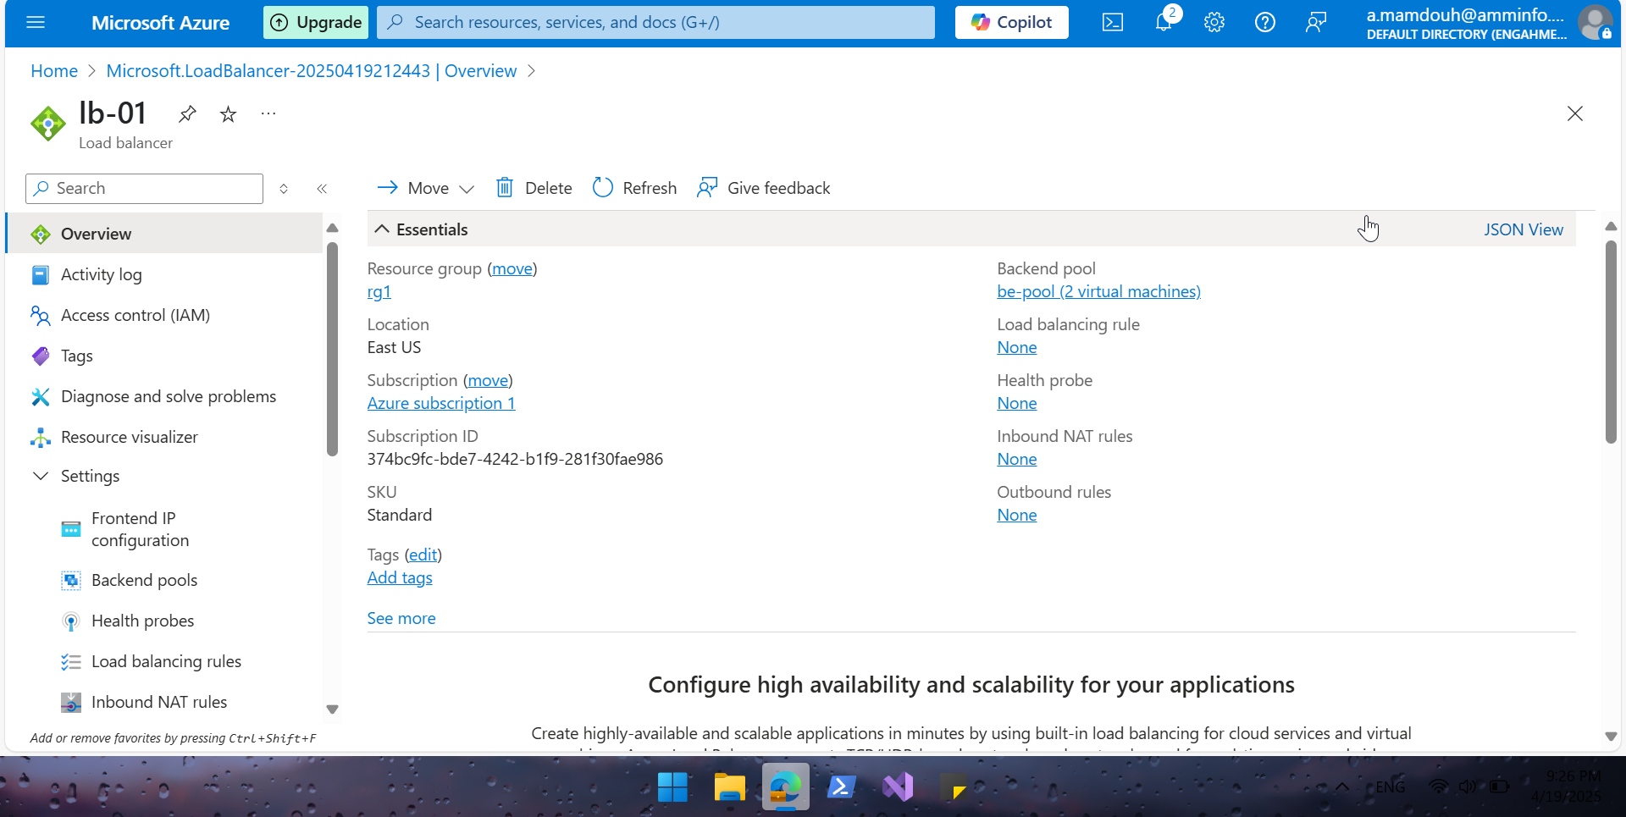

Slide 10
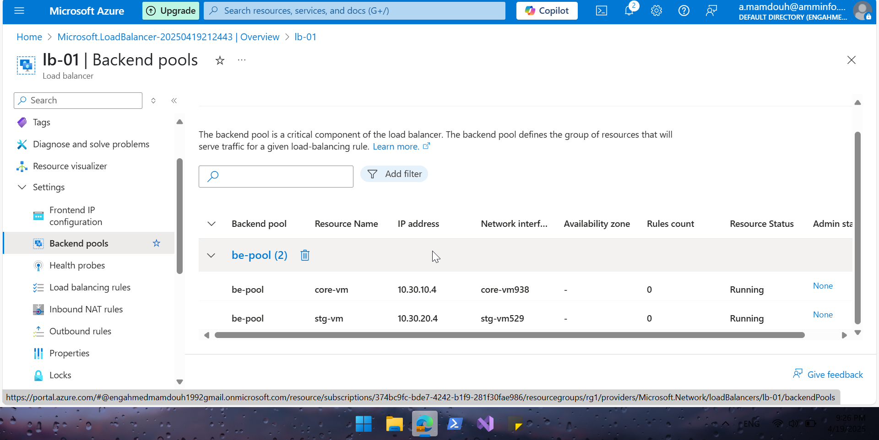
Notes:
Checked backend pool configuration

Slide 11
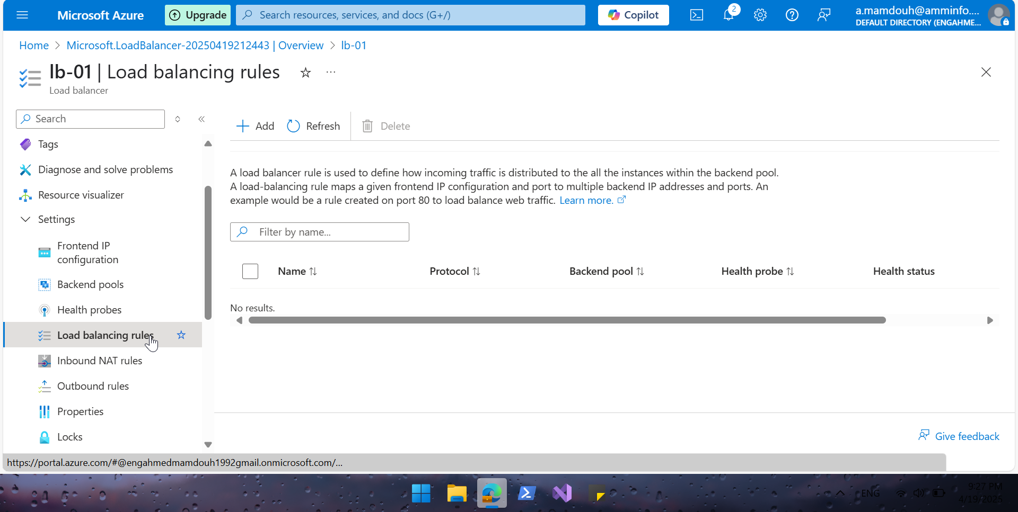
Notes:
Create Load Balance Rule to distribute incoming TCP traffic on port 80 (HTTP) across multiple backend servers.

Slide 12
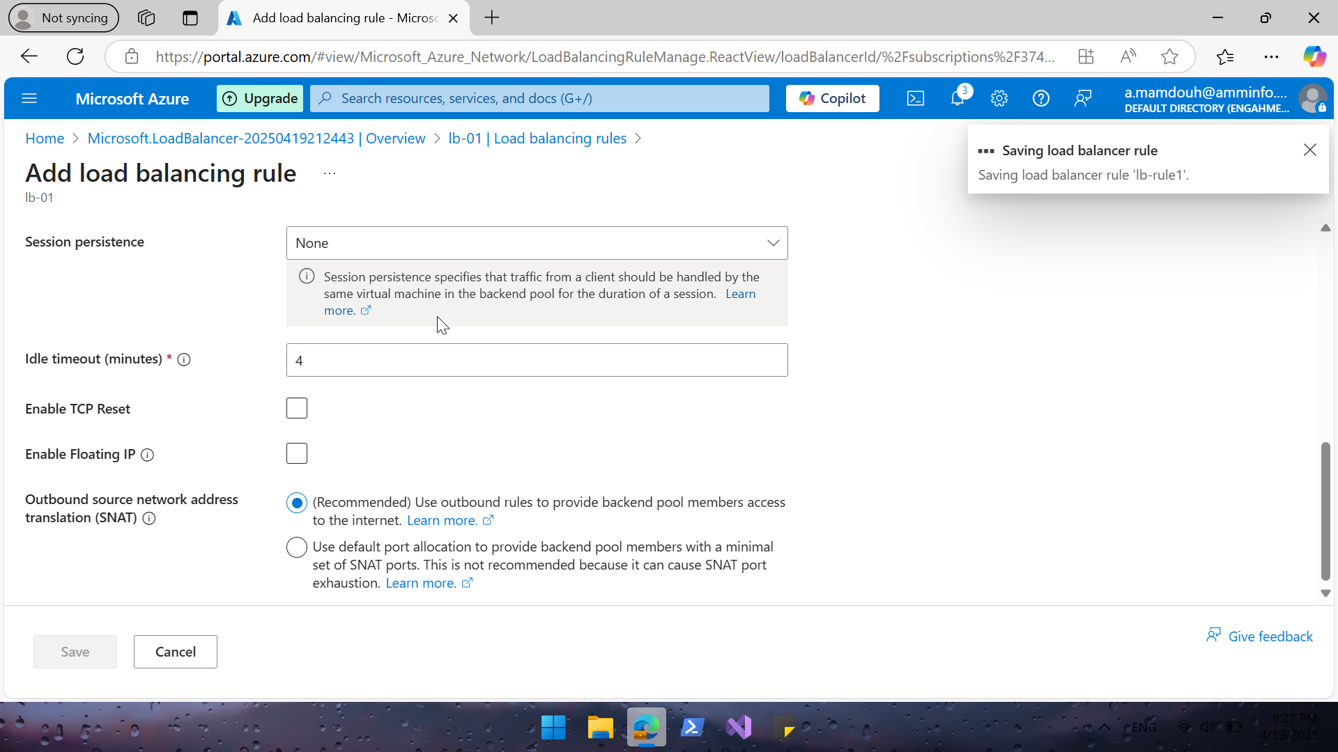

Slide 13
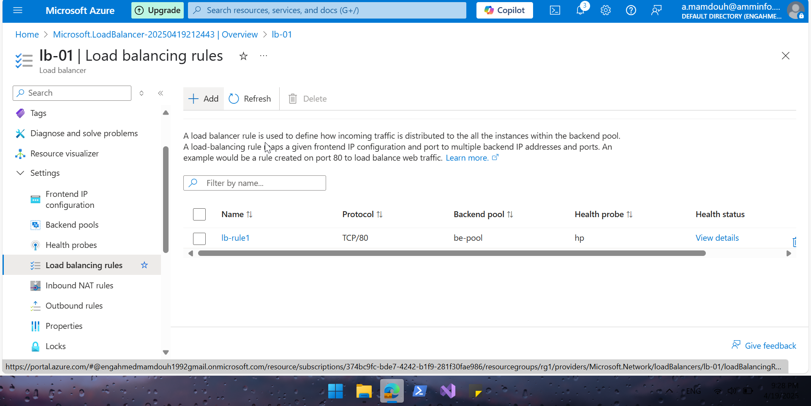
Notes:
distribute incoming TCP traffic on port 80 (HTTP)

Slide 14
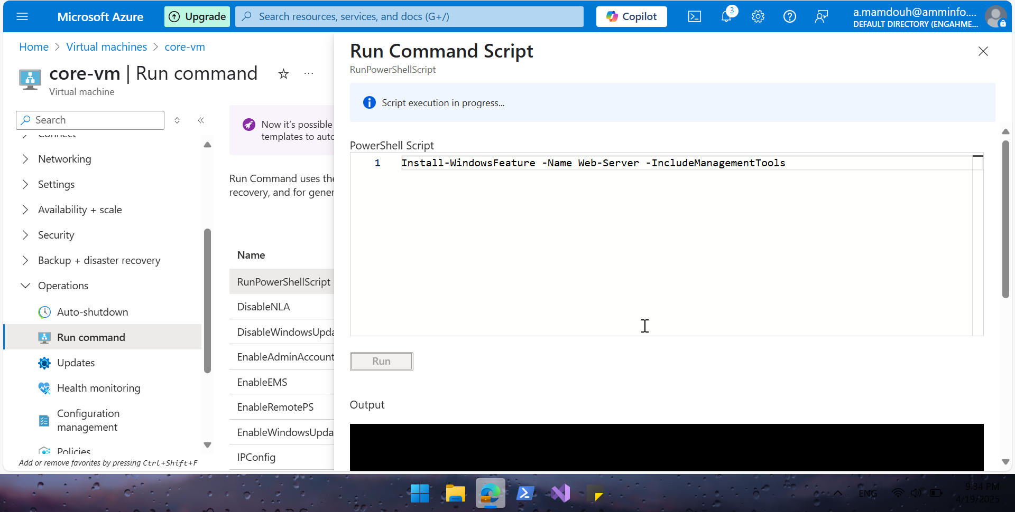
Notes:
install IIS feature on both vm using run command in vm-operation section

Slide 15
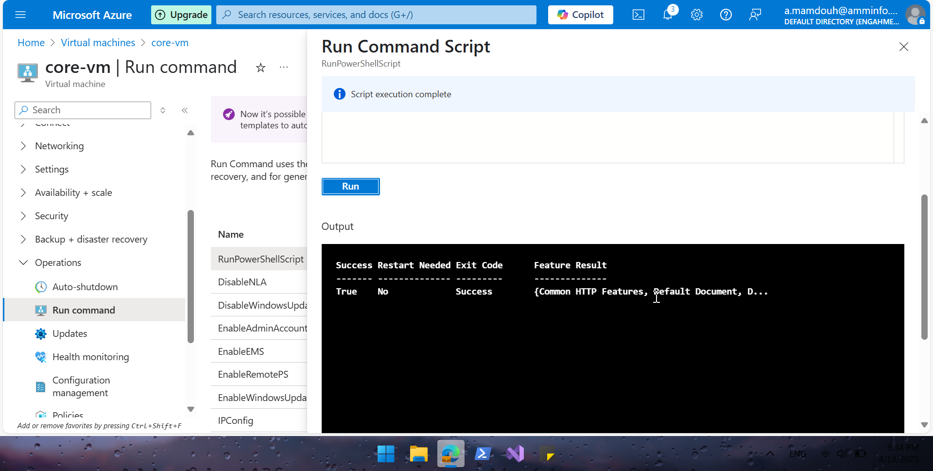
Notes:
Repeate run command on stg-vm

Slide 16
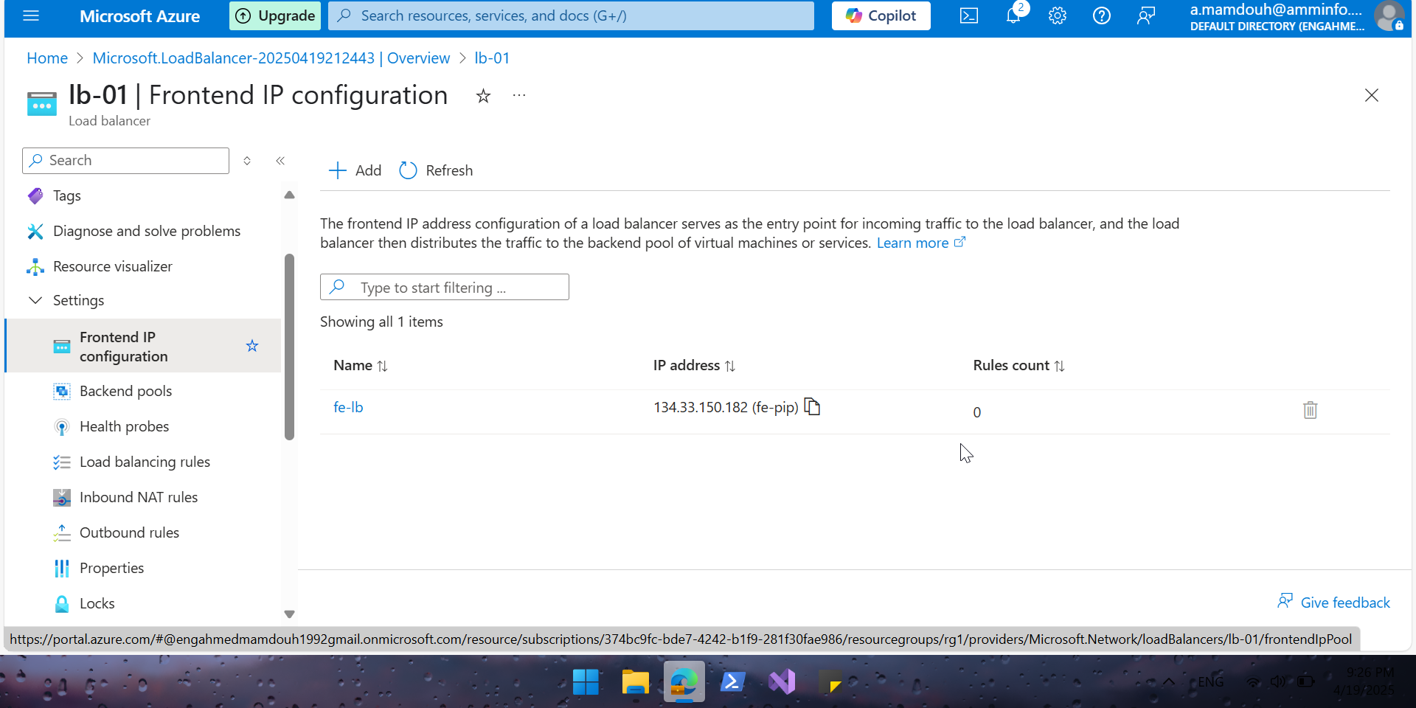
Notes:
Copy public ip and open it in a browser

Slide 17
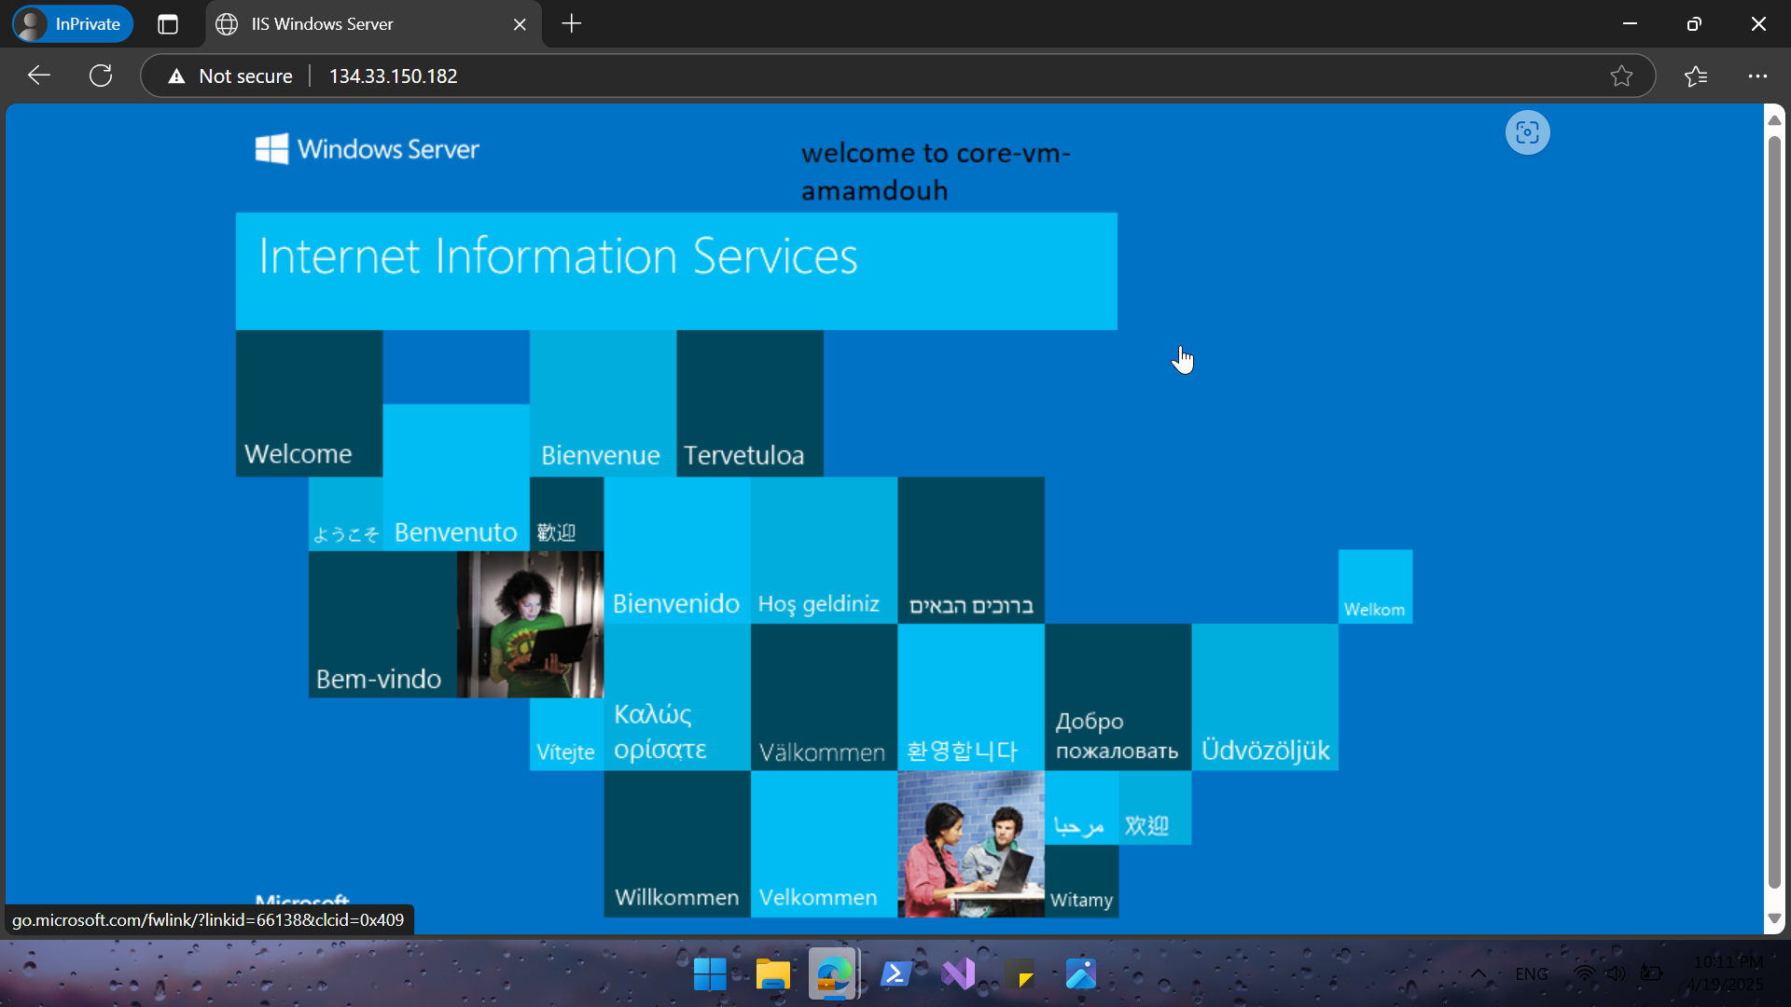
Notes:
Direct to Core-vm

Slide 18
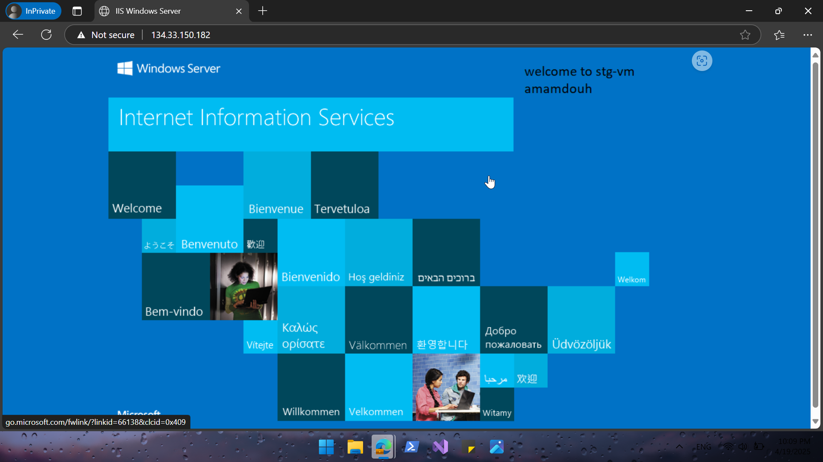
Notes:
Direct To Stg

Slide 19
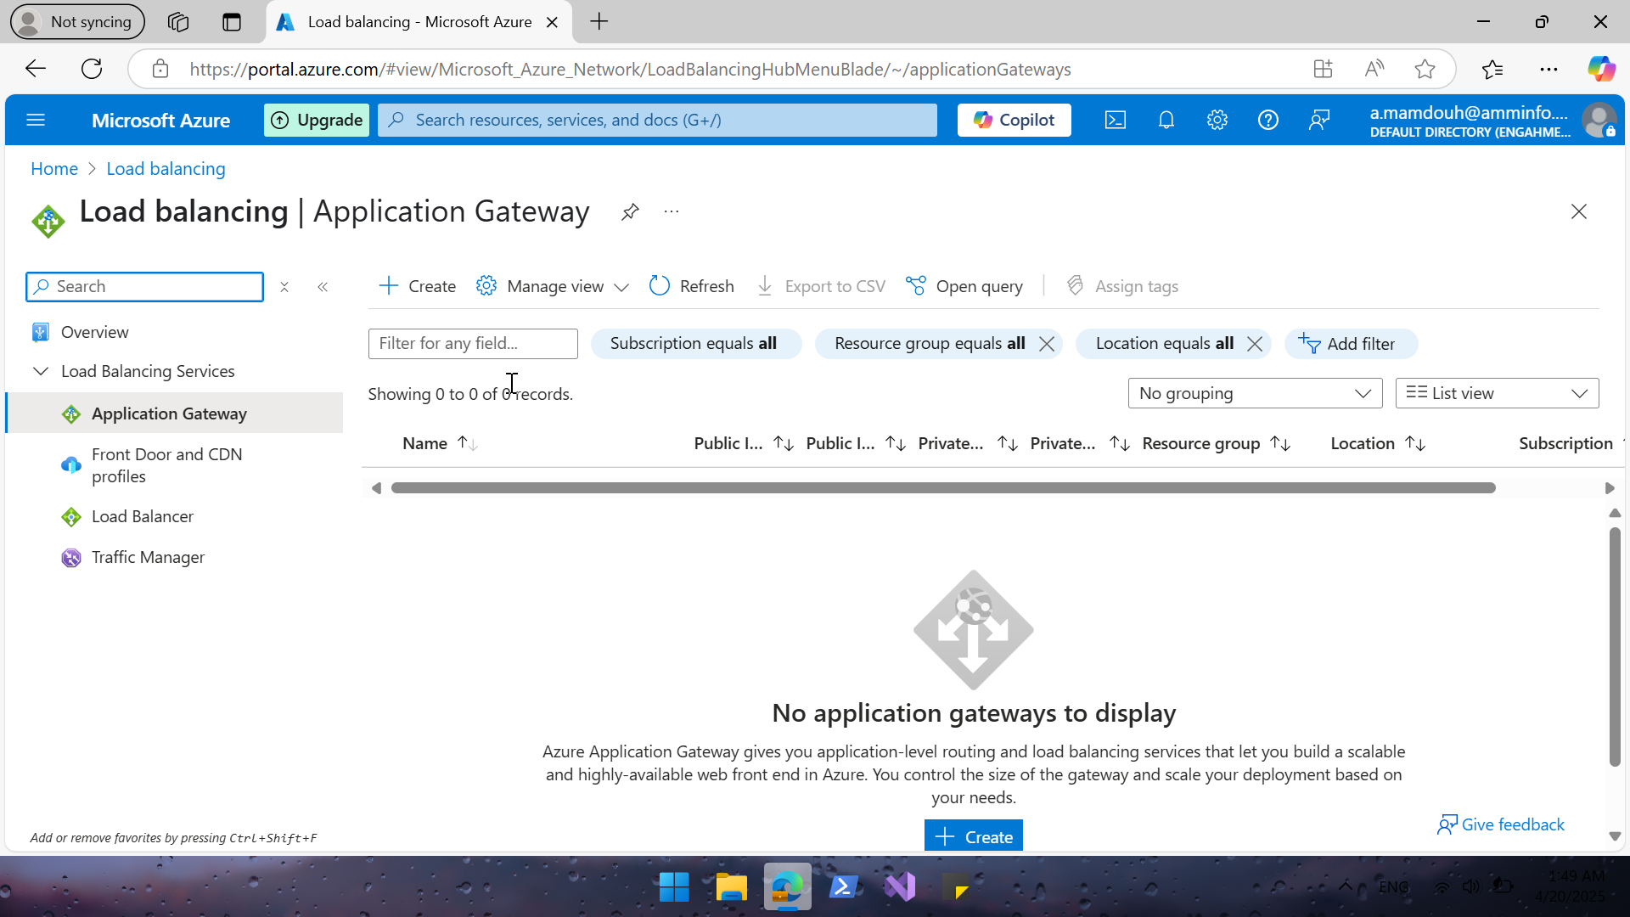
Notes:
Creating new Application Gateway

Slide 20
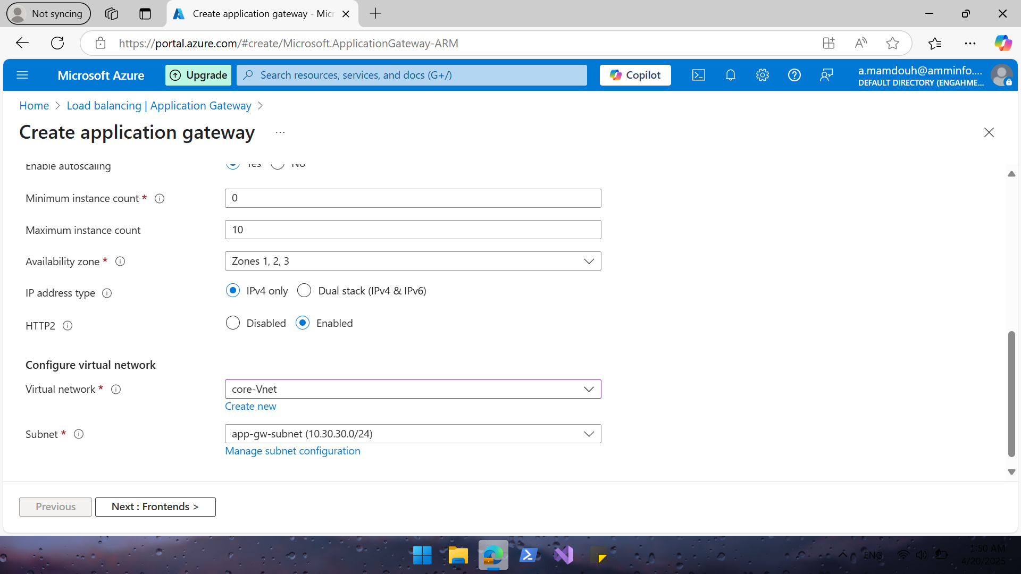
Notes:
Note that Application gateway need a dedicated subnet “10.30.30.0”

Slide 21
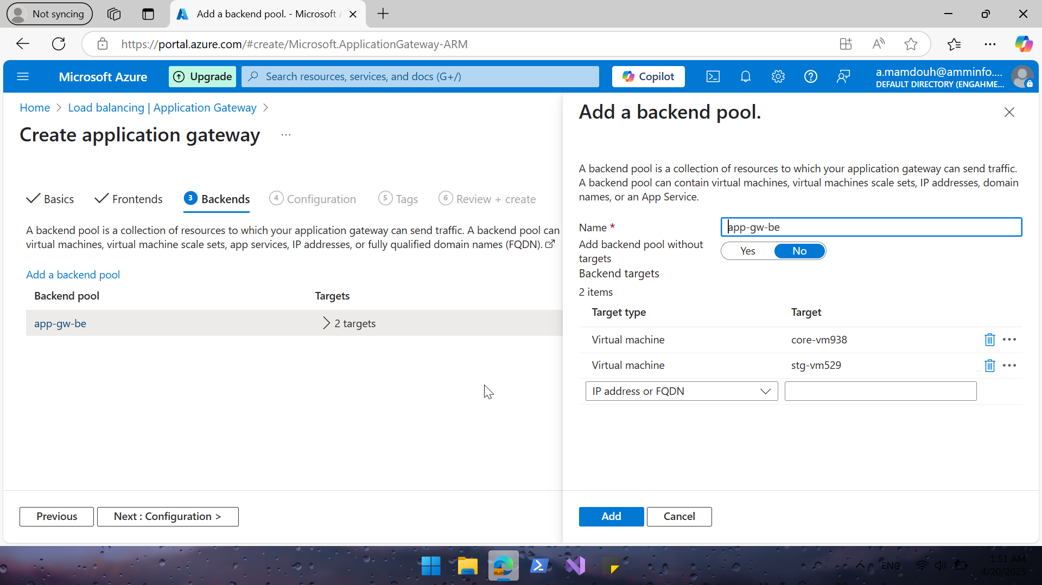
Notes:
Define backend pool add 2 vms “core & stg which I created before”

Slide 22
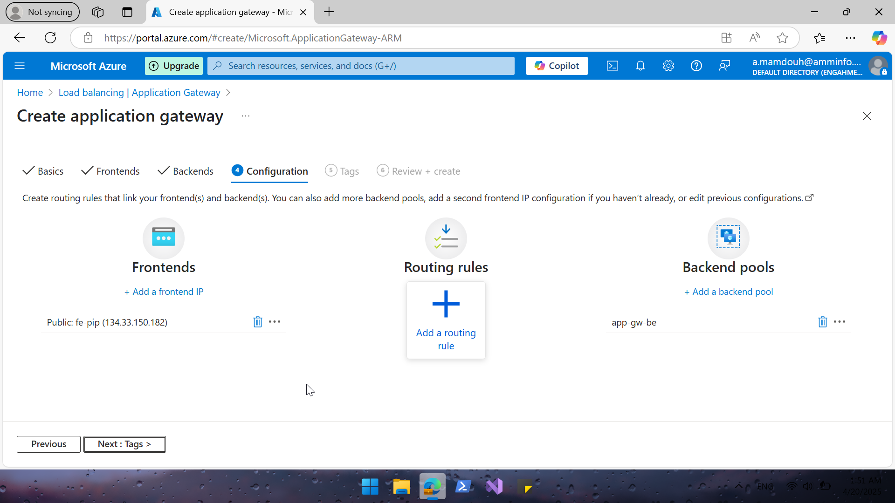
Notes:
Now I already configured frontend and backend of my web app

Slide 23
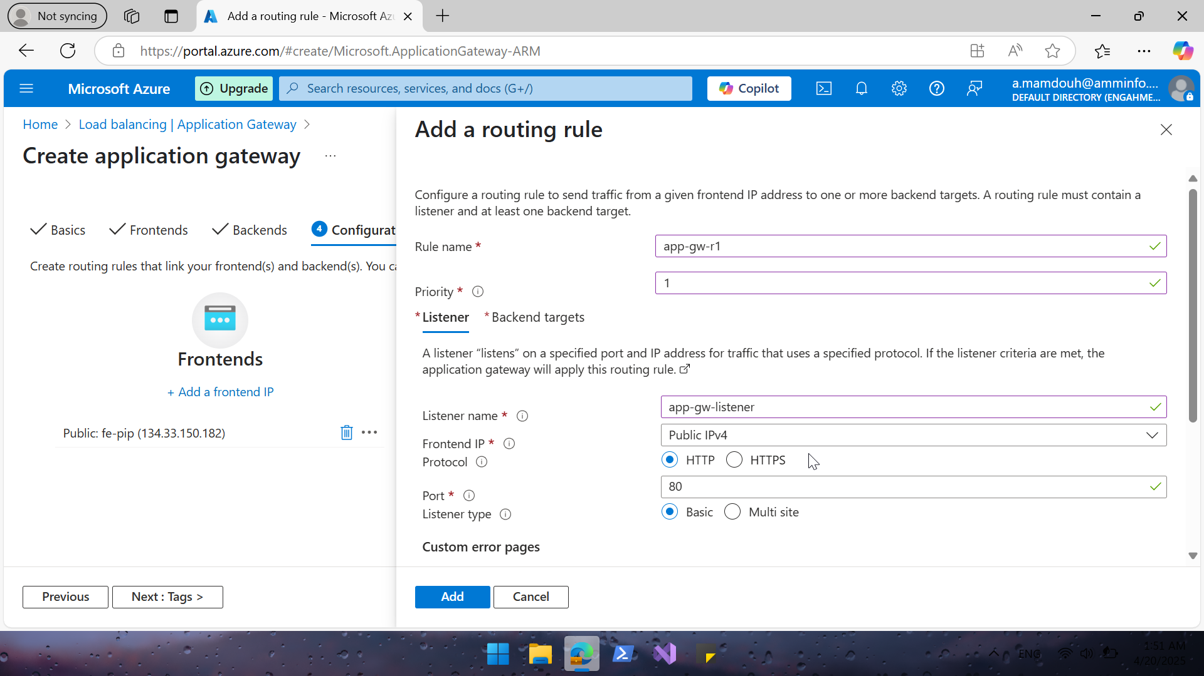
Notes:
Configure appgw-routing-rule to route and distribute incoming traffic from front end to backend “vms” on port 80

Slide 24
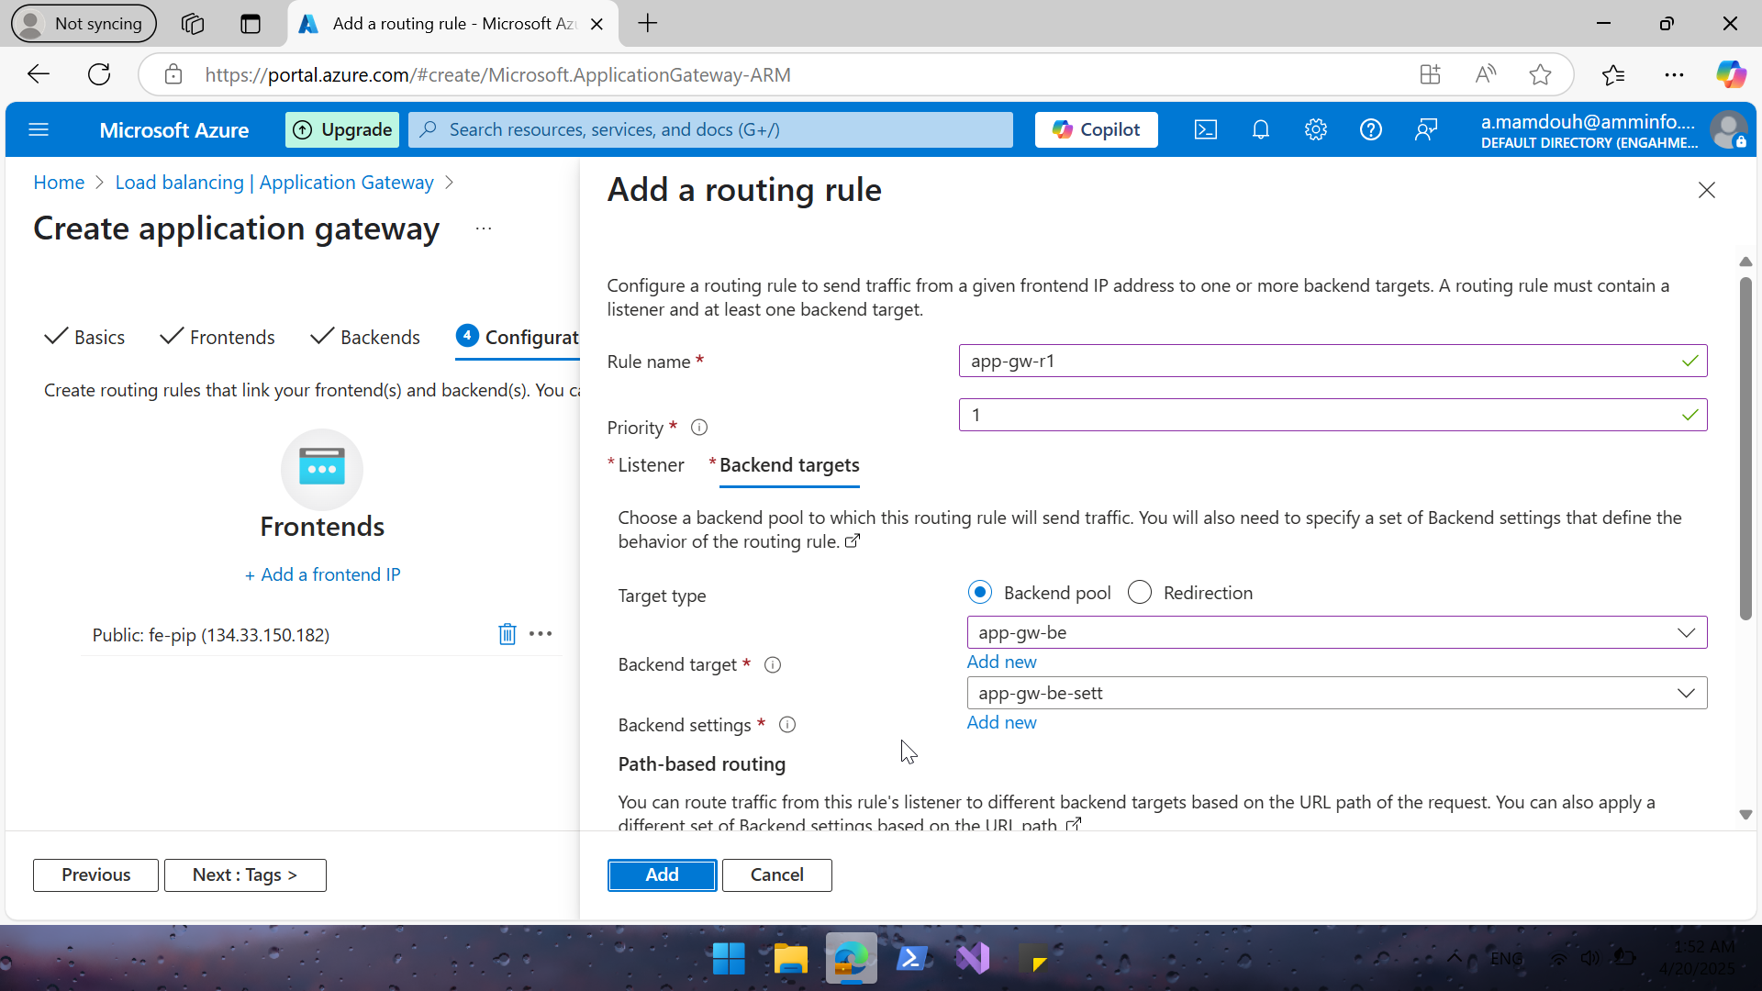
Notes:
Define backend target my-vms

Slide 25
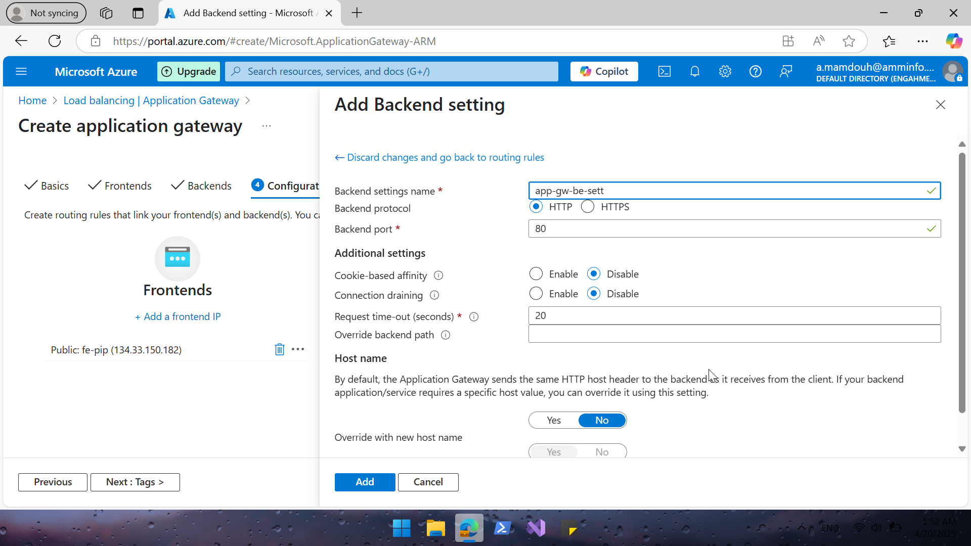
Notes:
Add new backend setting

Slide 26
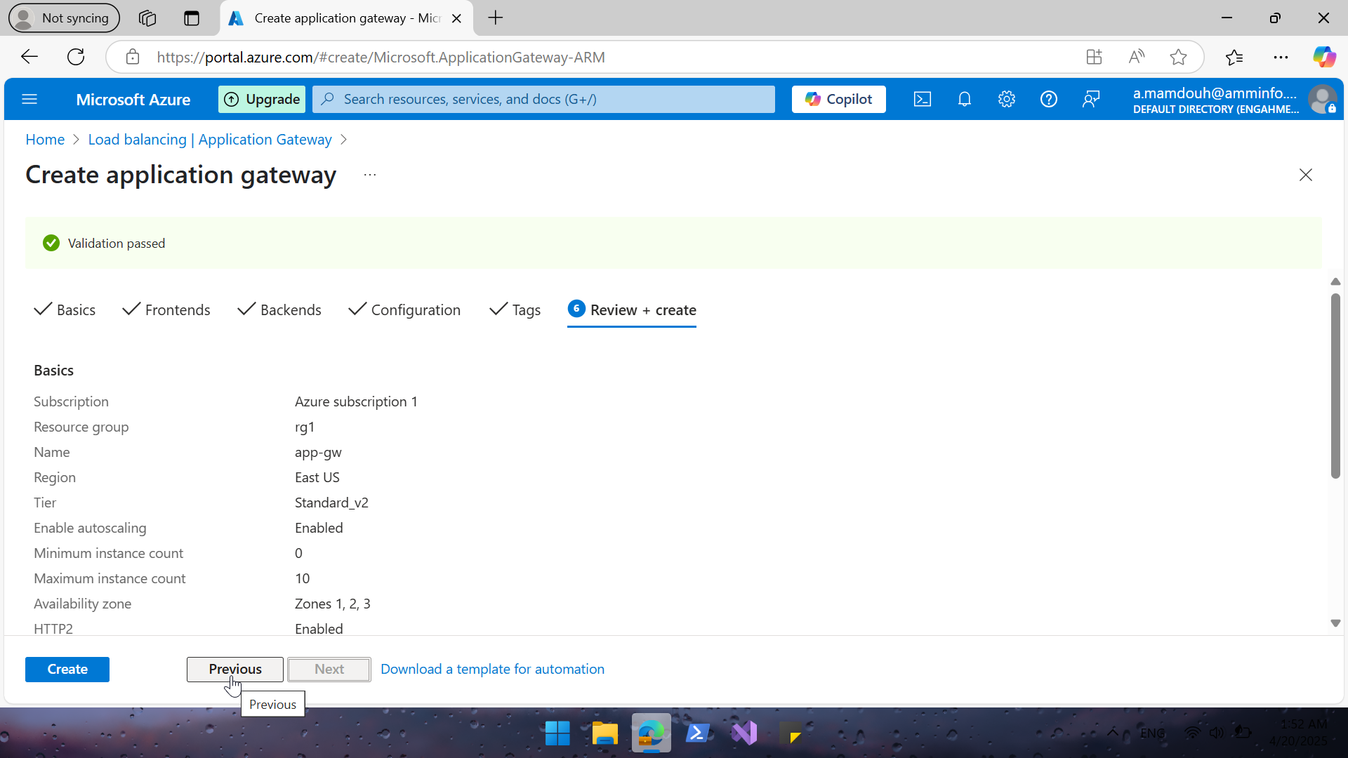

Slide 27
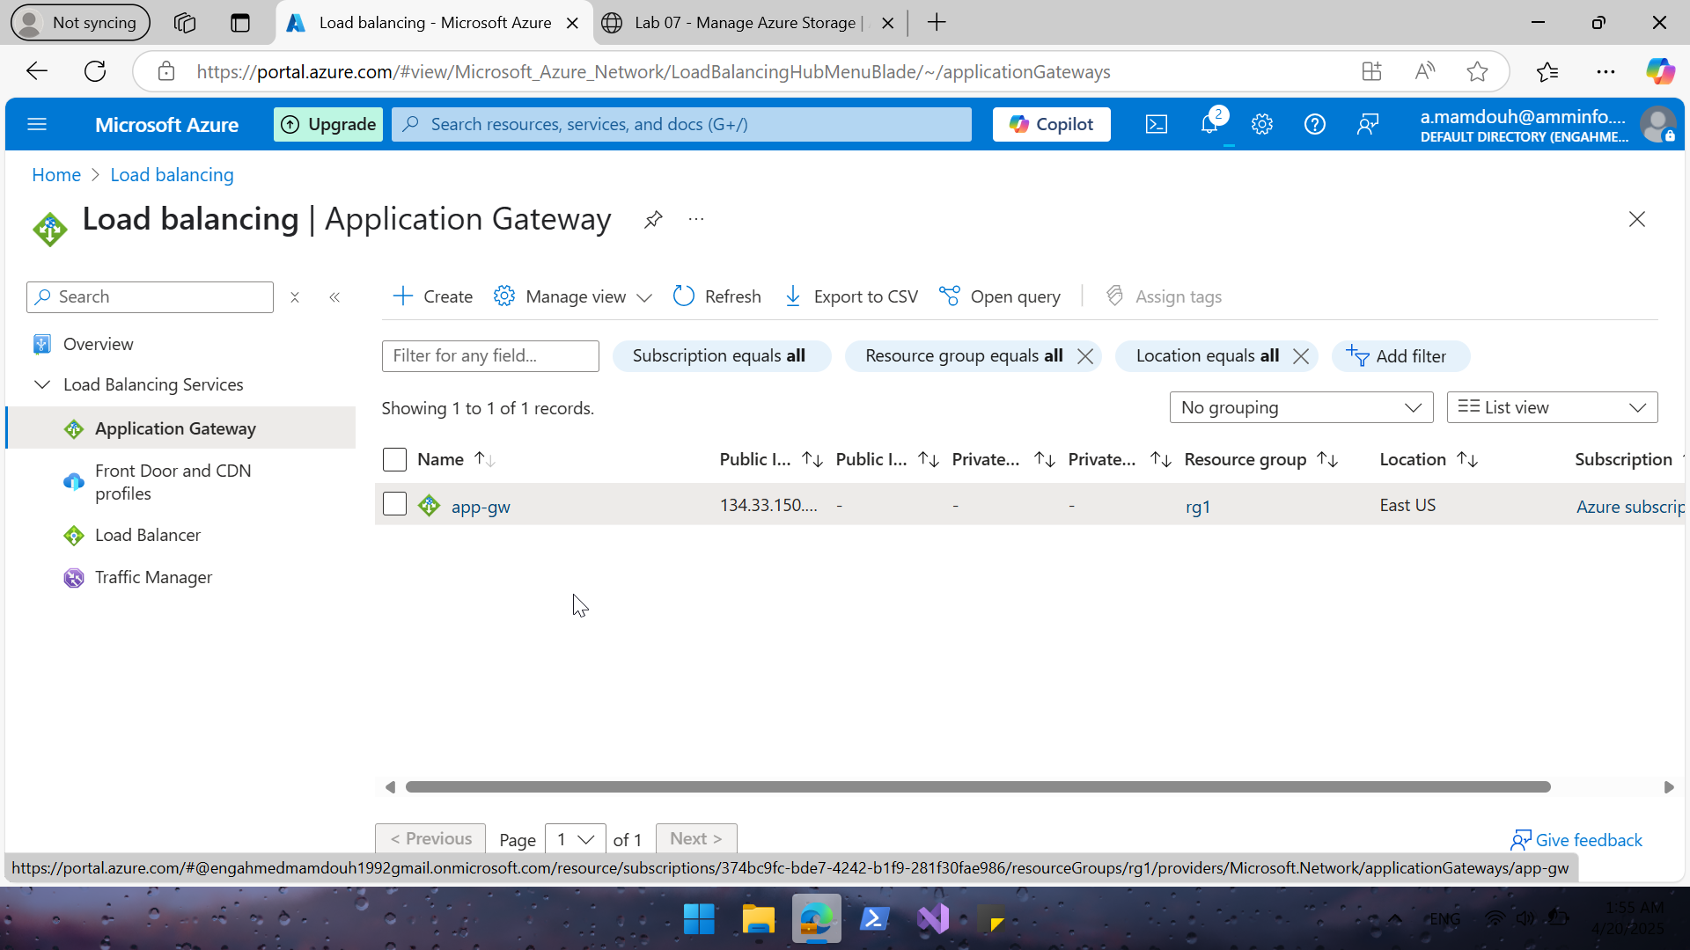

Slide 28
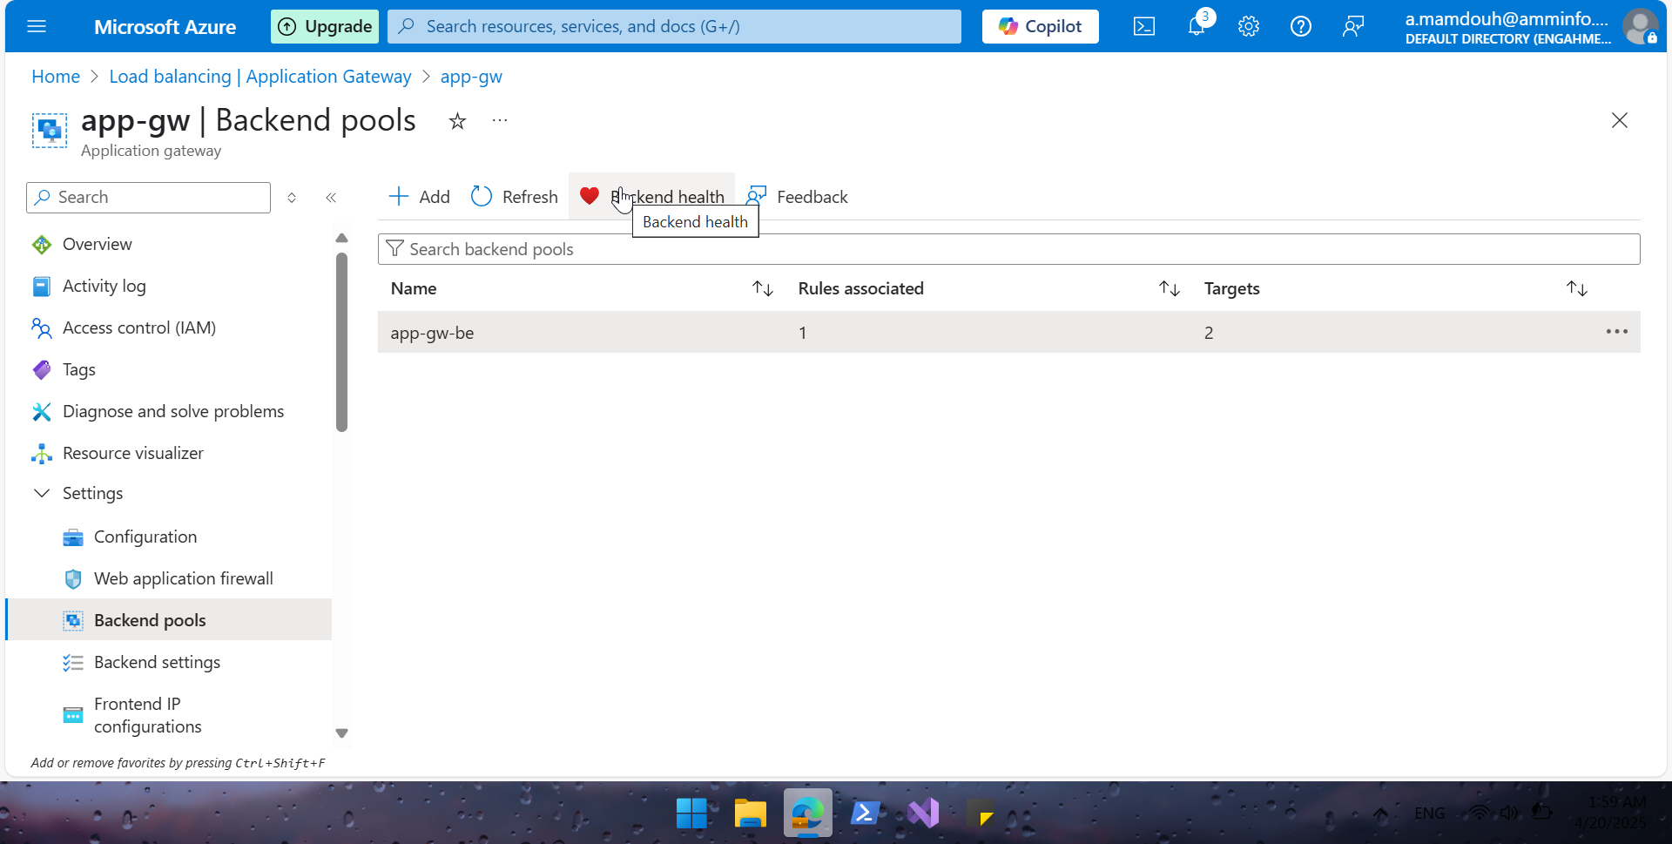

Slide 29
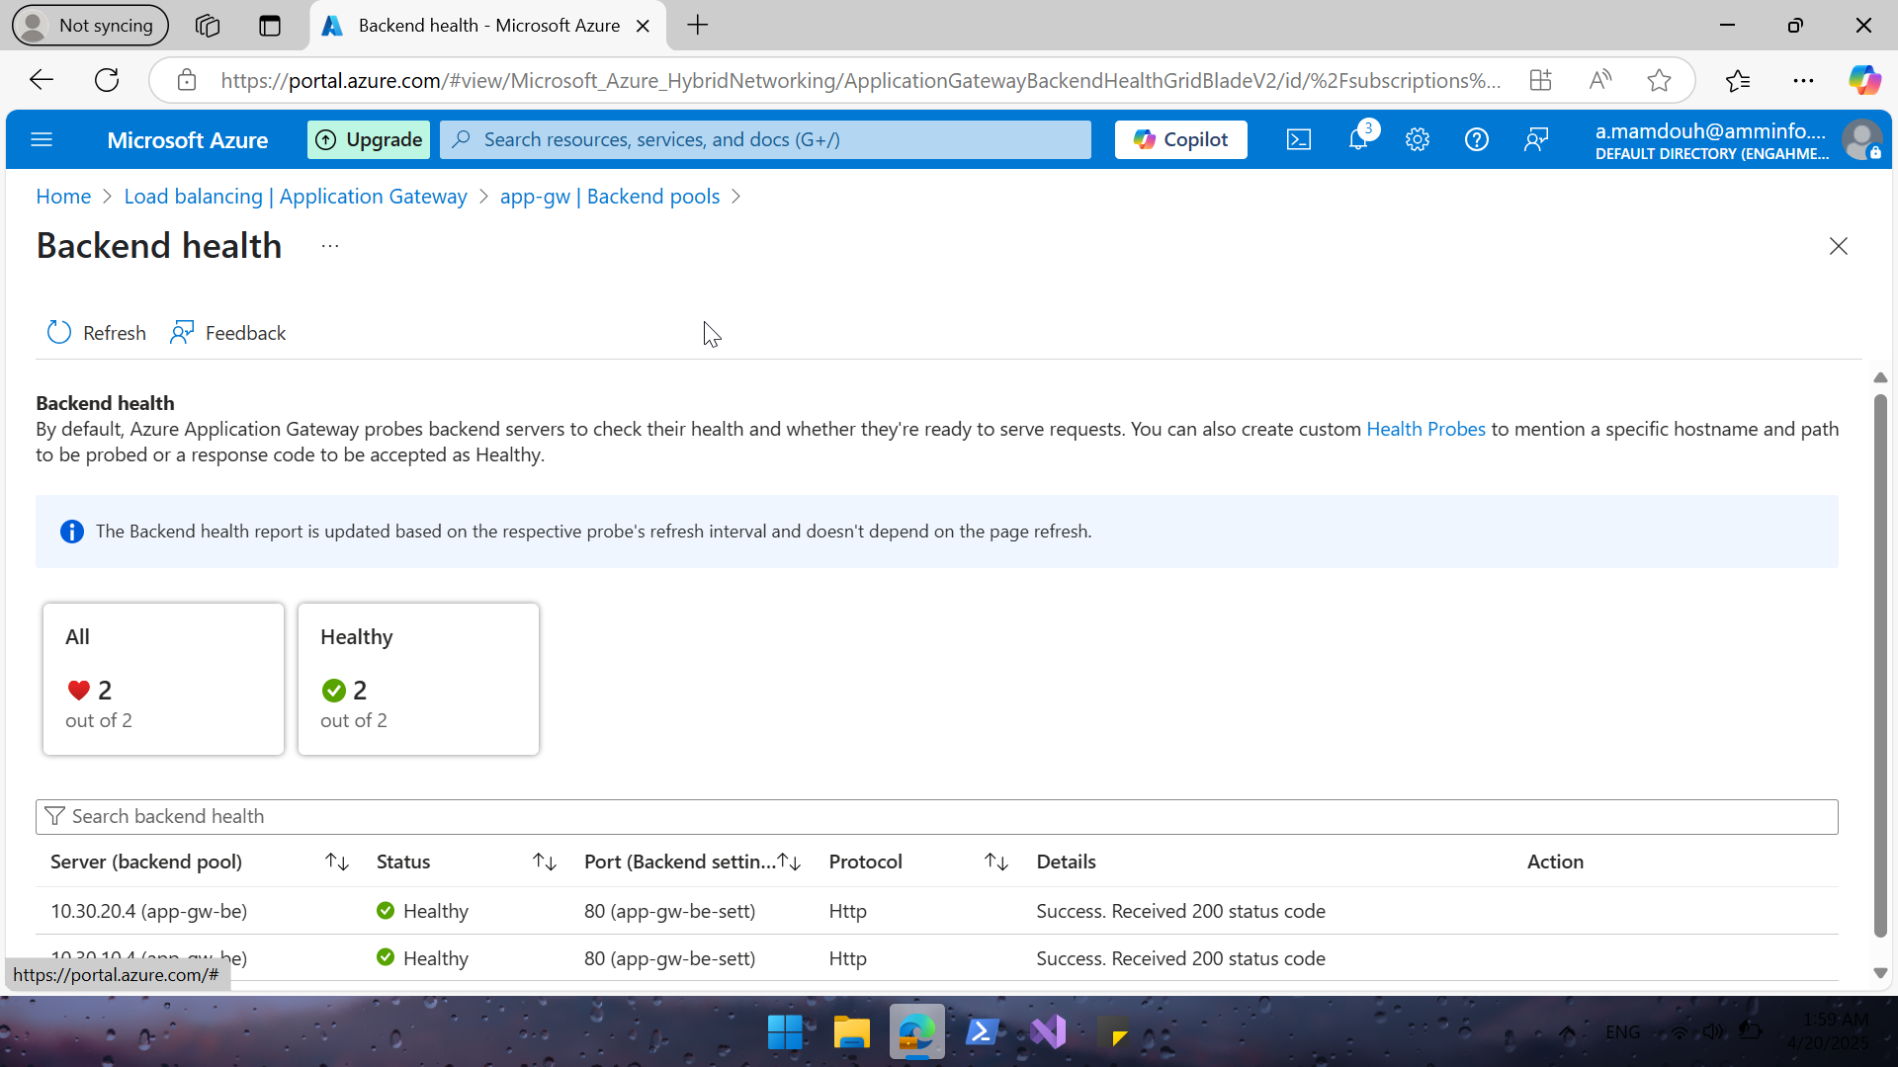
Notes:
My backend is healthy and vms are up and running

Slide 30
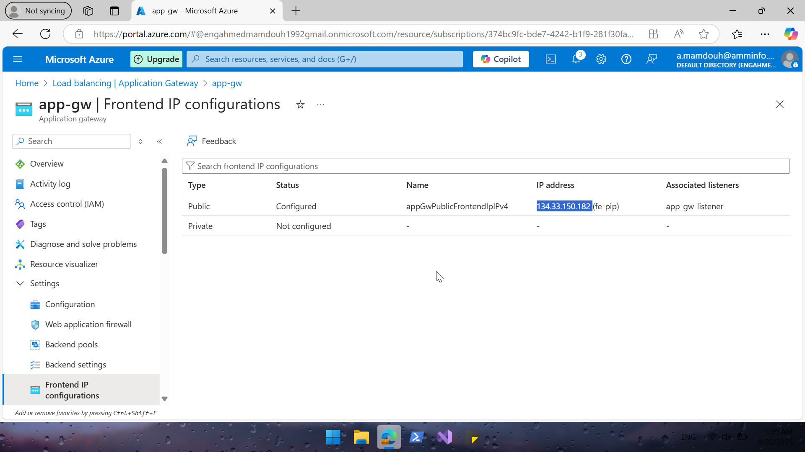

Slide 31
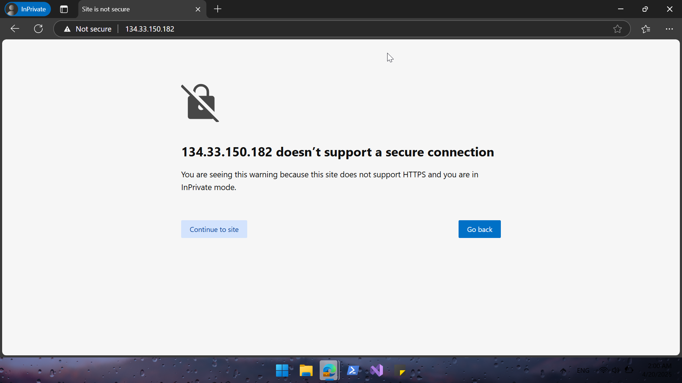

Slide 32


Slide 33


Slide 34
Load Balancer Options
Azure Load Balancer layer 4 transport layer Handles TCP/UDP traffic And Ideal for TCP load balancing like port 80.
Azure Application Gateway layer 7 Advanced HTTP/HTTPS load balancing with URL routing, SSL termination as features . Use this if you're doing web app-level routing.
Azure Front Door layer 7 Global HTTP/HTTPS load balancing. Good for public-facing web apps across regions.

